Slide 1

SEBA CONSTRUCTION
AND
DRILLING COMPANY
PROFILE

Slide 2
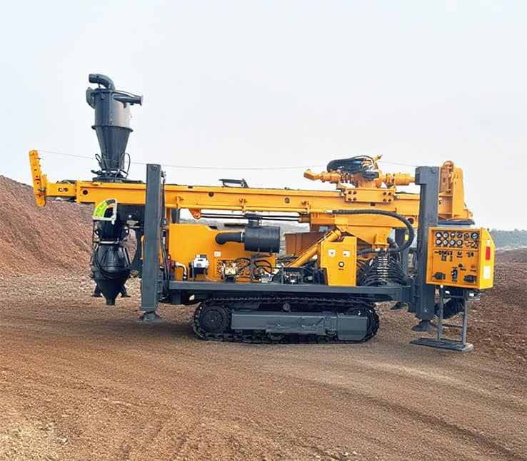
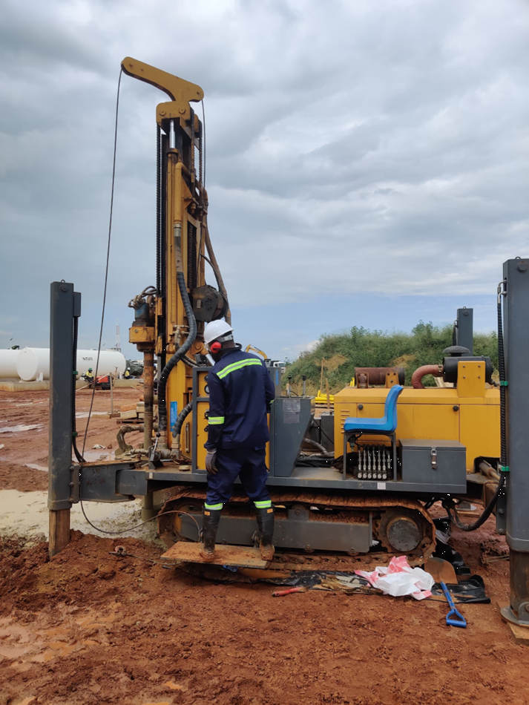
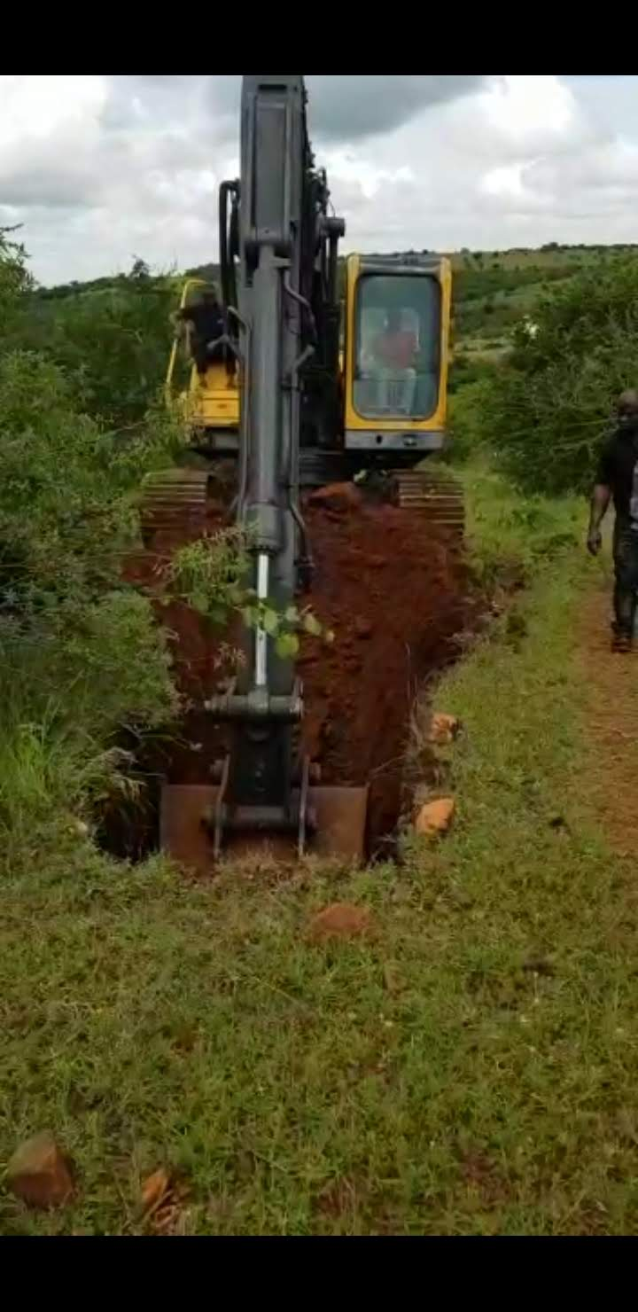
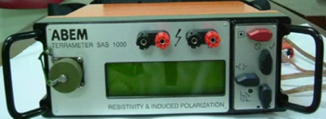
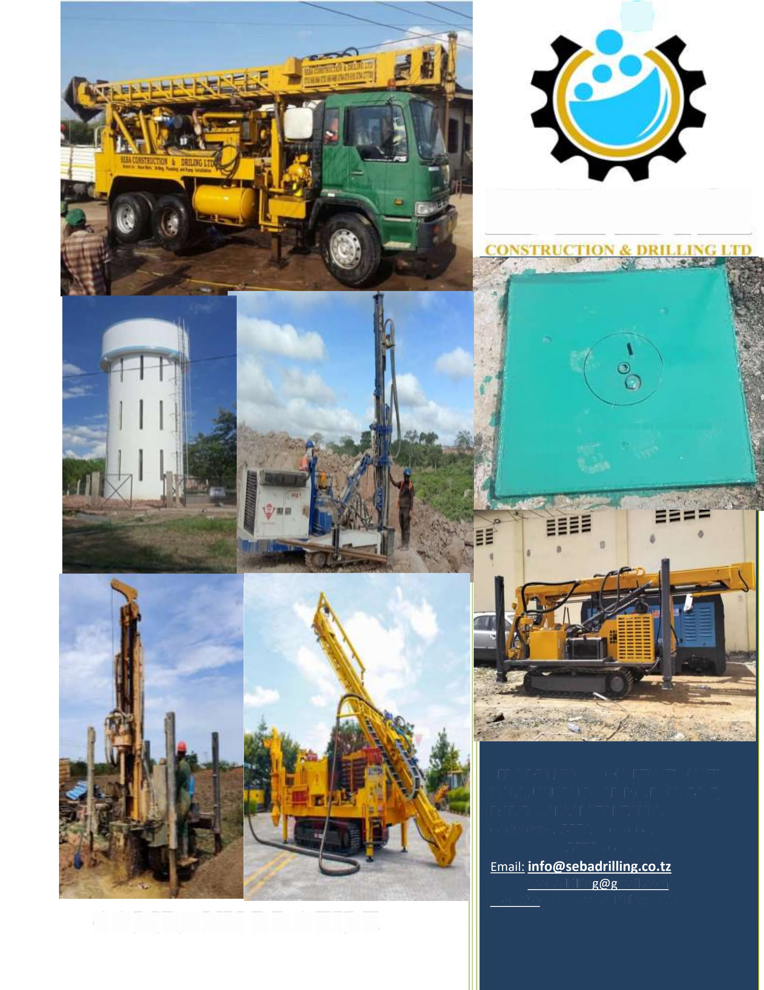
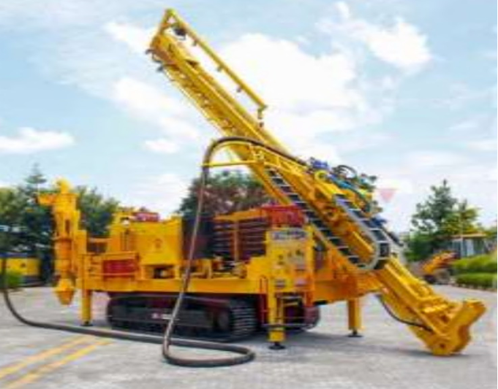
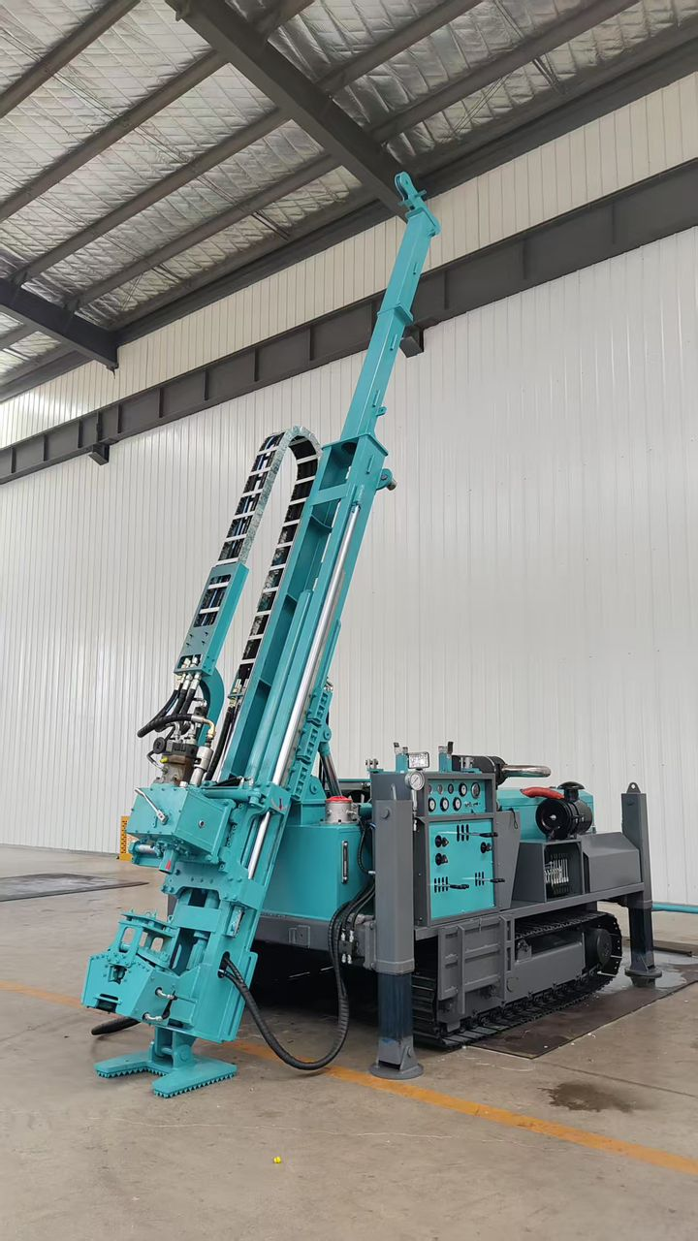
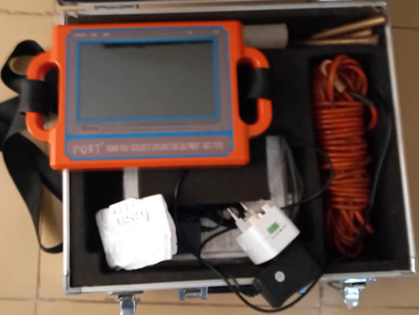
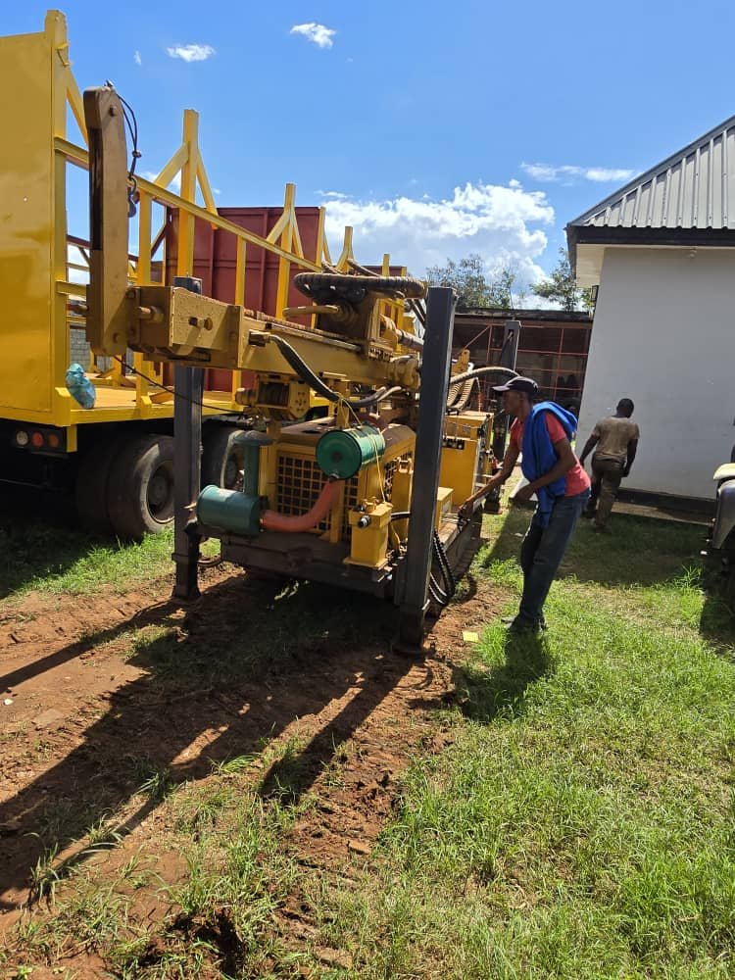
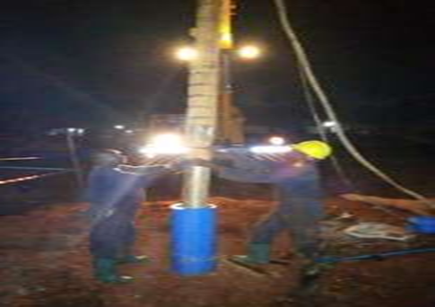

Slide 3
About us:
Seba Drilling and Construction Ltd is a local firm which was established in 2008, in 2009 it started to
provide consultancy and services in areas of Geophysical, Hydro geological and Geological surveys, Drilling and Construction of water wells, pump installation and servicing, design of small water supply schemes. Now our Company deals with groundwater exploration, irrigation, drilling for sample collecting, Diamond Drilling, blasting hole drilling. In 2012 it’s when our company registered in Civil and Building Contractor and Kick started our journey in construction works. Until 2024 we undertook Water project, Irrigation scheme projects, Building construction, Dam construction and a number of Road construction Projects.

Slide 4
OUR MISSION:
Seba construction and Drilling Company is a company established by highly qualified and experienced staff with a very high reputation in their field of expertise, as private limited company, to contribute towards promoting self-reliance and social progress in Tanzania.
Seba construction and Drilling Company is dedicated to providing clients with personalized service, unmatched in the drilling industry. We guarantee to meet the demands of your project in a timely, cost-effective manner, while upholding our standard of superiority. At Seba construction and Drilling Company, we strive to maintain a professional work setting in which integrity, excellence and safety is maintained.
We value the importance of our relationship and we will continue to remain fair and true in dealings with all employee, clients and Partners.

Slide 5
OUR VISION:
To provide good quality and on time completion of all projects we undertake.
To be the preeminent provider of superior construction and drilling services by consistently the quality of our projects.
To add value for clients through innovation, foresight, integrity and aggressive performance and to serve our clients with honor.
Transforming dreams and imagination into concrete reality. We aim to innovate, inspire and build sustainable future for Tanzania.

Slide 6
OUR FOCUS:
Seba construction and Drilling Company we have a sound background and expertise in the areas of Construction ,Reverse Circulation (RC)drilling, Diamond drilling, Blasting hole drilling, Borehole drilling, Borehole design, Ground work, Borehole pump equipping, Borehole rehabilitation, Water treatment, Pump testing ,Dewatering service in all mining and installation.
The guiding philosophy and focus behind our services are to provide a High standard construction as per scope requirements, All construction and Drilling projects as per project scope, supply and improve sanitation to diminish the negative impact on health as well as boosting the economy without harming the environment.

Slide 7
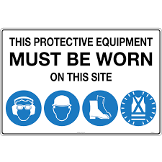
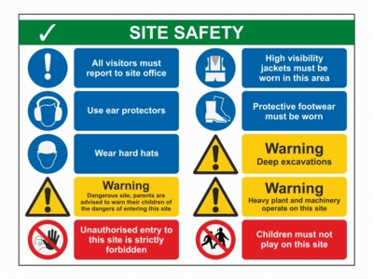
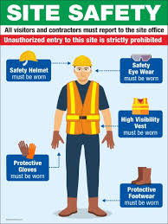
HEALTH,ENVIRONMENTAL AND SAFETY POLICY
Seba construction and Drilling company safety to us is the most important attribute to all our activities.
We ensure the health,safety,security and work environment of all the members pertaining all activities including all visitors.
To make environmental assessment and mitigate all impacts that may occur during and post construction activities at the community.
To adapt all practical measures to protect and maintain the environment.
To comply to all safety and environmental Regulations.
OUR FOCUS:

Slide 8
OUR SERVICES AND PROFICIENCY:
We are experts in drilling works: Seba construction and Drilling Company has been performing drilling works in the Tanzania region 13 years with this experience in mind, we have extensive knowledge in the field of borehole drilling, Reverse circulation (RC), Diamond drilling, blasting hole drilling and understand requirements of specific customers as well as projects.
Borehole Drilling
The drilling is carried out by using the “Down-The-Hole” (DTH) technology.
This system works by using high compressed air built within our drilling rig. The size of the hole can vary depending on the requirement of the client.
As the drilling process continuous, geological rock samples are taken at 1meter intervals. Struck and water rest levels are constantly recorded.
This process enables us to estimate the yield of individual aquifers encountered.
OUR FOCUS:

Slide 9
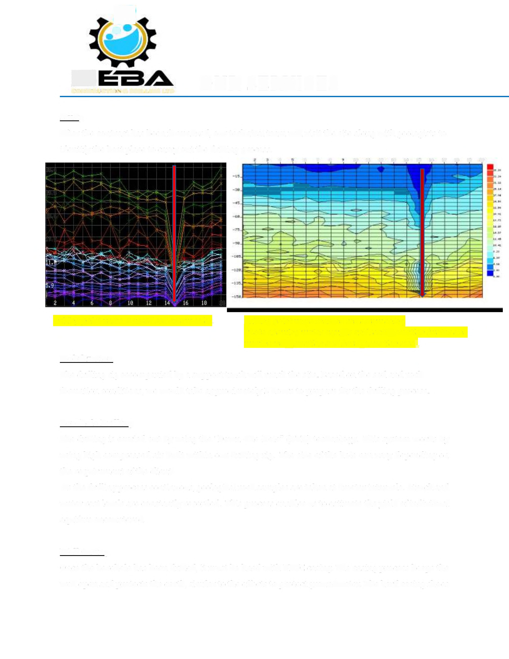
OUR SERVICES AND PROFICIENCY:
Study
After the contract has been formalized, our technical team will visit the site along with geologists to identify the best place to carry out the drilling process.
All marked area are the low anomaly for borehole drilling point. We did ERT (Electrical resistivity Tomography) this method of hydrogeological survey show all shallow and deep Aquifer.

Slide 10
Well Casing
The hard casing shoes up the wellbore and extends through both the verticality and the horizontal drilling phases, assuring the long-term integrity of the well from end-to-end. In addition to providing stabilization and keeping the sides of the well from caving in on themselves, casing protects the well stream.
Once the borehole has been drilled, it must be lined with UPVC casing.
The casing process keeps the well open and protects the earth, similar to the efforts to protect groundwater.
Well Development.
Once the screen, pack, seals and backfill have been installed, the well is developed.
This development aims at repairing the damage done to the aquifer during the course of drilling by removing clays and other additives from the borehole.
This also alters the physical characteristics of aquifer around the screen and removes fine particles.
The use of over pumping as a means of development is not advocated since it only increases permeability in zones which are already permeable.
Instead, we recommend mechanical surging with a plunger or the use of air or water jetting which physically agitates the gravel pack and adjacent aquifer material.
OUR FOCUS:

Slide 11
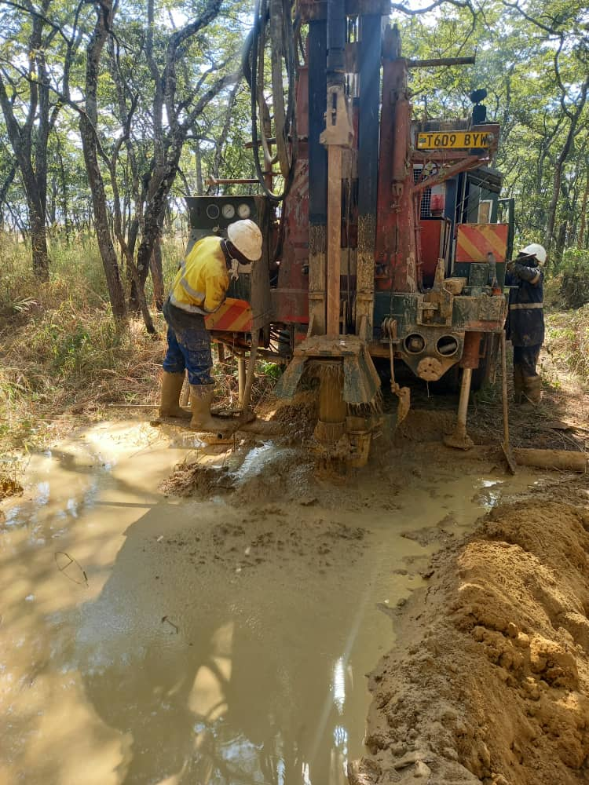
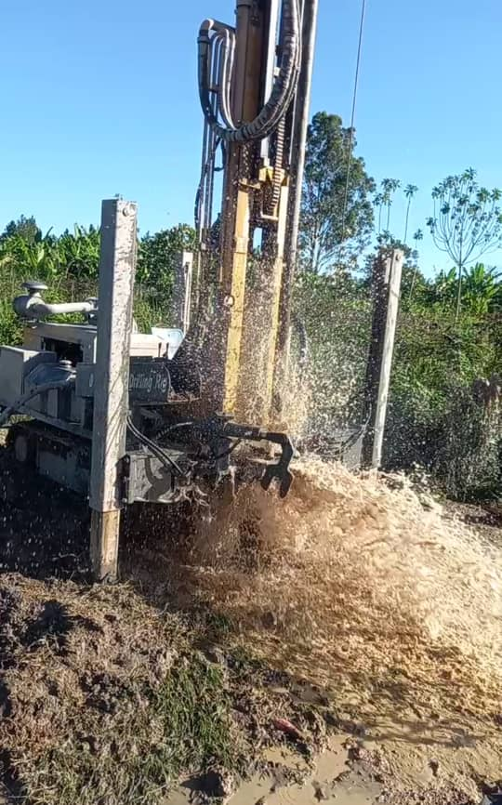
Borehole Drilling and Development photos of some of our projects.
OUR FOCUS:
dddd
Drilling at Stamigold Biharamulo Monitoring Boreholes photos as shown.
Drilling at Ruwasa Misenyi water project, Boreholes photos as shown.

Slide 12
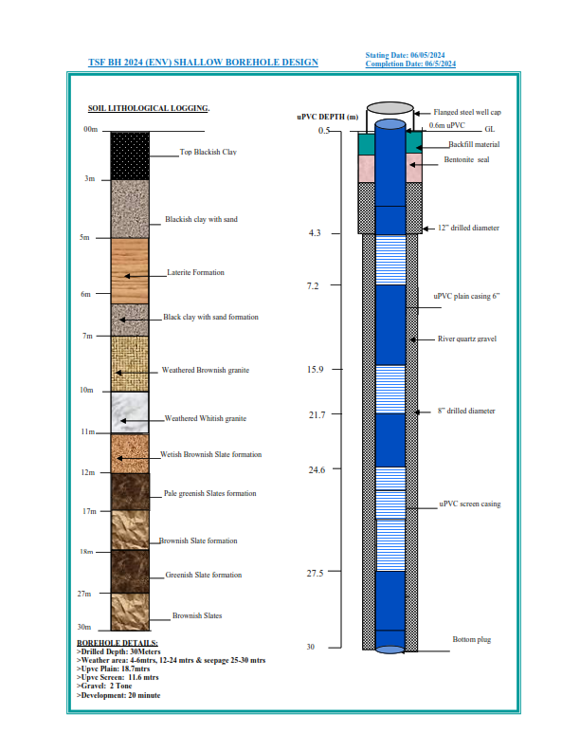
Upvc Installation Borehole design in our completion Reports, photos of some of our projects.
Our Upvc chart installation Borehole design Combined all data of the borehole drilling as follow,
Drilling Diameter
Reaming Diameter and depth,
Temporary casing installed depth and size,
Soil/rock sample lithology and color.
All place weathered formation and All aquifer strike..
Upvc size installed
Upvc plain installed in meters.
Upvc Slotted installed in meters
Gravel size pack in mm and quantity.
Development of the borehole.
Blow yield or V notch test ,to measure water yield.
Photo show example of Borehole Design of our project.

Slide 13
Well Testing
After development and preliminary tests, a long-duration well test is carried out. Well tests have to be carried out on all newly-completed wells, because not only does this give an indication of the success of the drilling, design and development, but it also yields formation on aquifer parameters which are vital to the hydro geologist.
A well test consists of pumping a well from a measured static water level (SWL) at a known or measured yield, and recording the rate and pattern by which the water level within the well changes. Once a dynamic water level (OWL) is reached, rate of inflow to the well equals the rate of pumping. Today, it is a common practice to carry out a 'step drawdown test', in which the yield is increased stepwise. Each step is continued until hydraulic equilibrium is reached after which the yield is increased with 50 to 100%. Towards the end of the test a water sample of 2 liters is collected for chemical analysis.
OUR FOCUS:

Slide 14
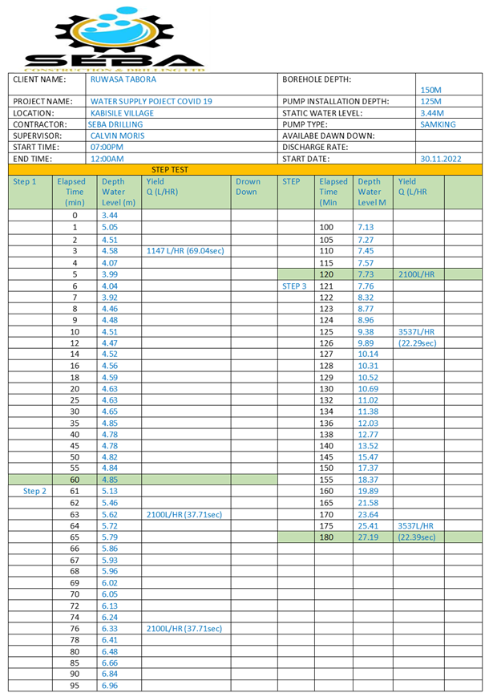
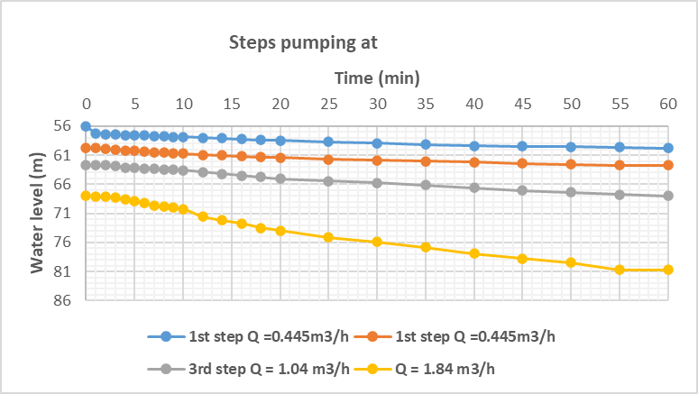
Well Testing Step pumping test
Example of step pumping test data and graph

Slide 15
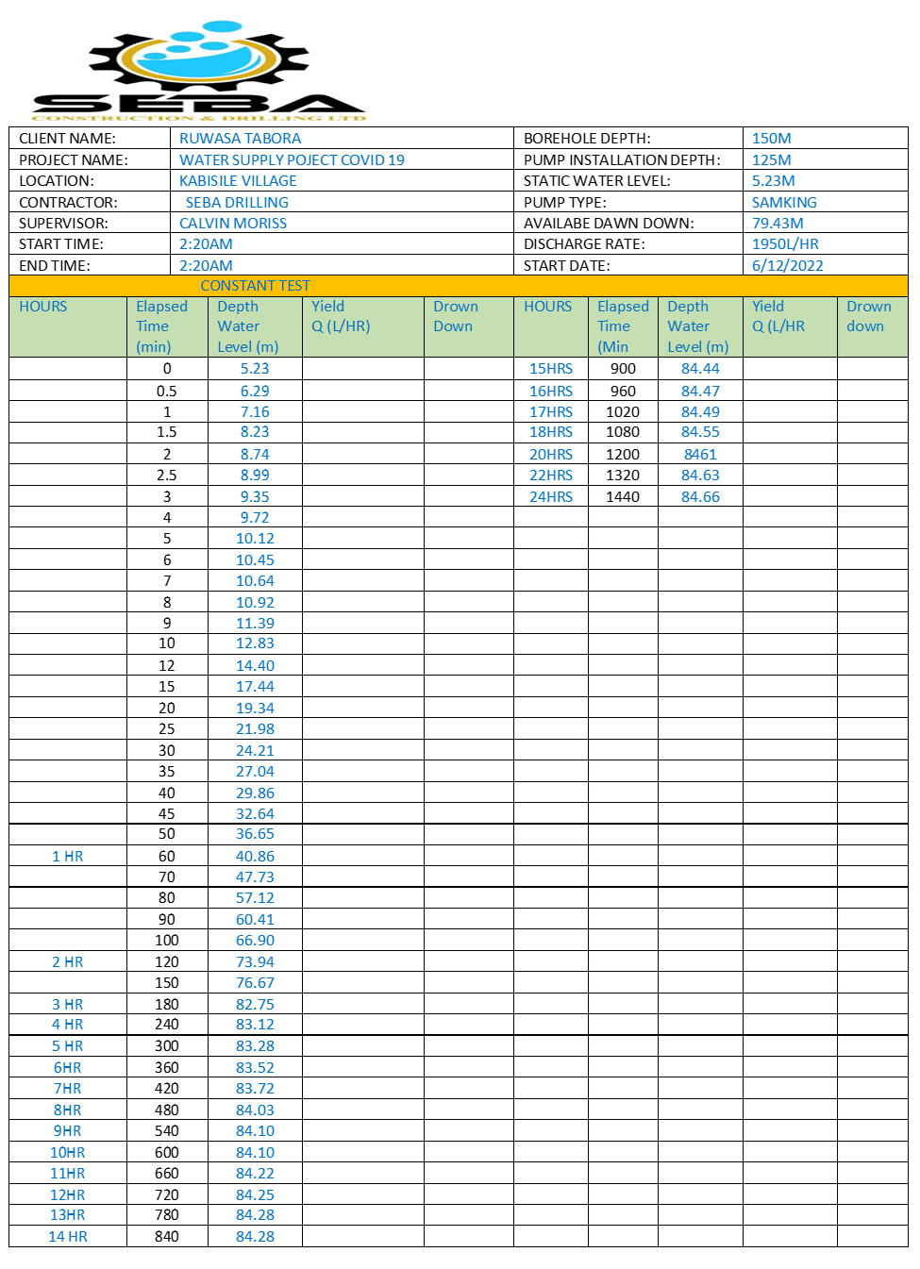
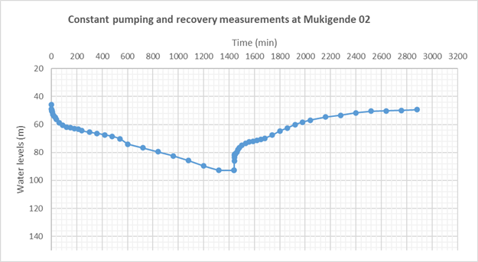
Well Testing constant pumping test
Constant pumping Rate 5000L/HR
Drown Down
Recovery
Example of Constant pumping test data and graph

Slide 16
Dewatering project
Dewatering and Depression borehole Drilling We are experts in dewatering: Seba construction and Drilling Company has been performing Dewatering and Depression borehole drilling at Bulyanhulu gold mine ,Upper west box cut Project, we have extensive knowledge in the field of Dewatering and understand requirements of specific customers as well as projects.
Well point system(shallow excavations, sandy soil)
Deep well(large & deep borehole drilling around the mine pit wall to pump all water to avoid fall of the pit wall).
Sump Pumping(small, Temporary Works)

Slide 17
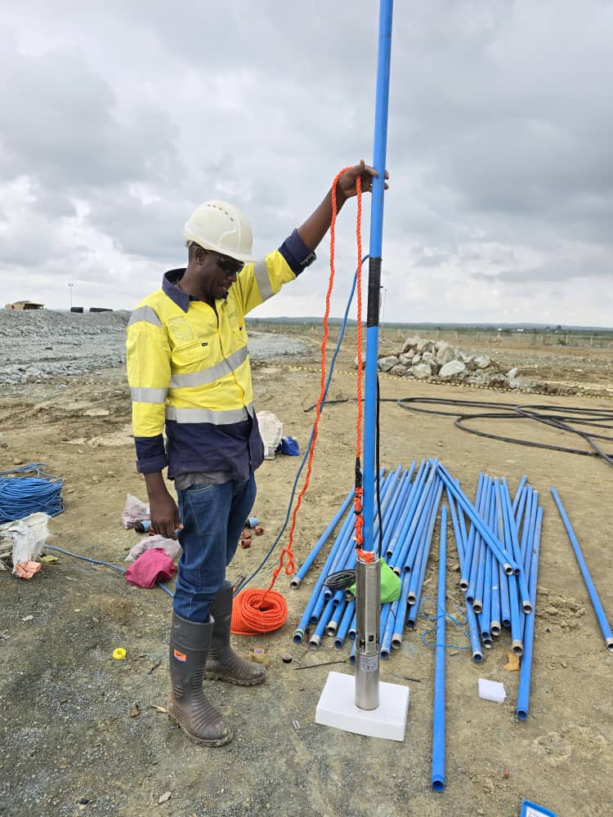
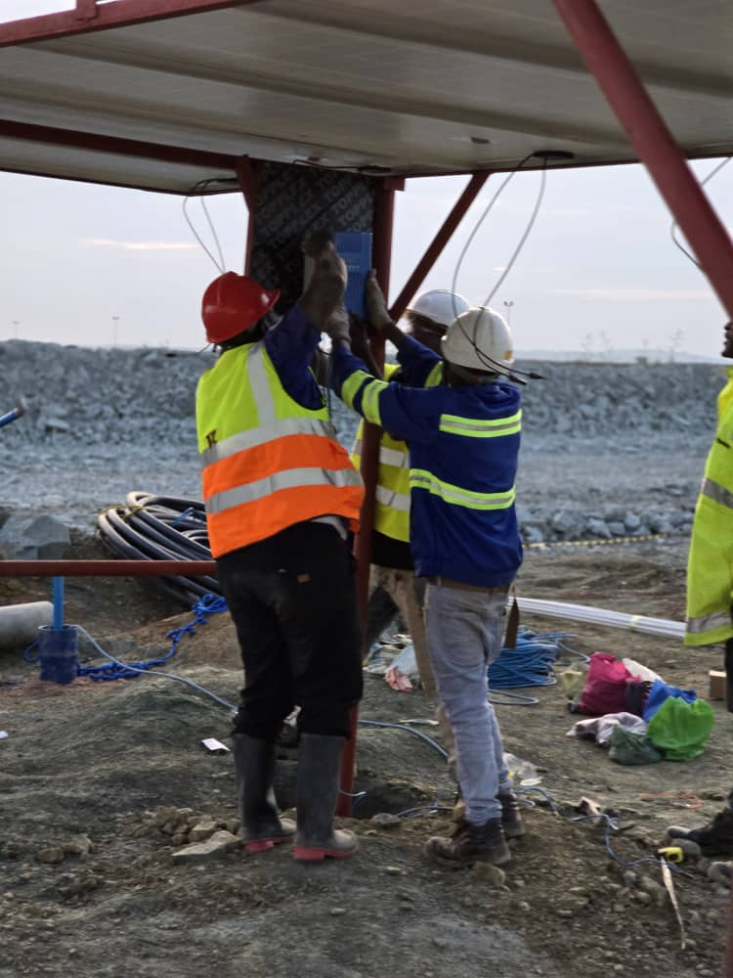
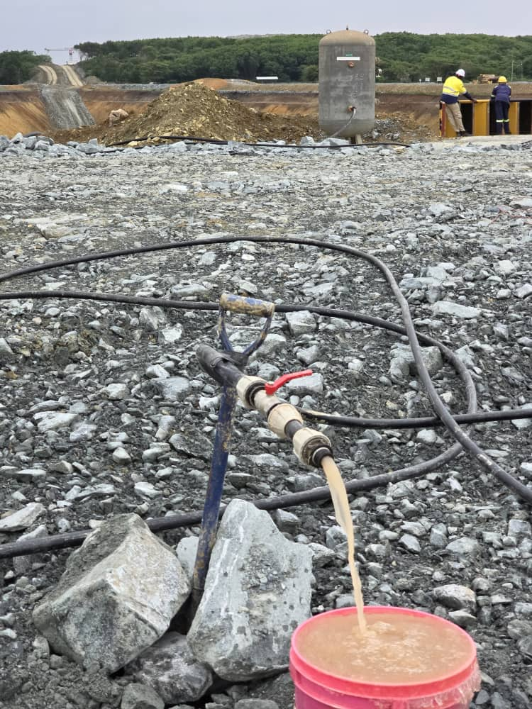
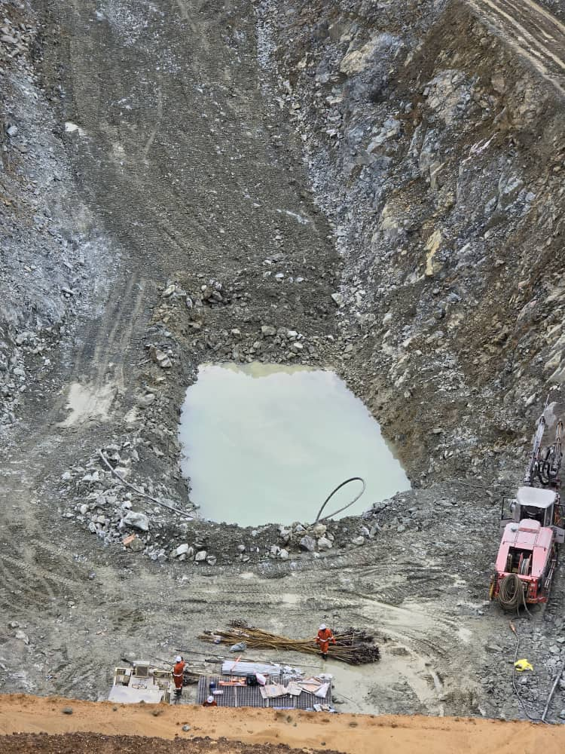
Dewatering pumps

Slide 18
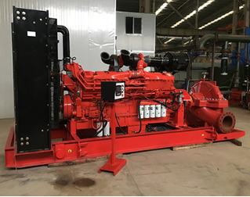
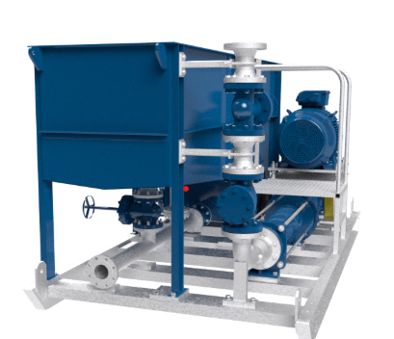
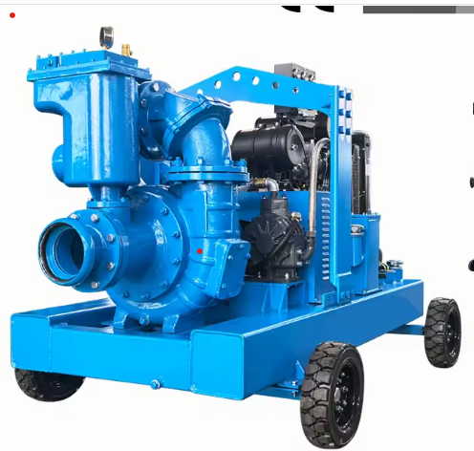
Dewatering pumps
Dewatering pump
Mobile-Diesel-Water-Pump-Centrifugal-Dewatering
DynaWaterPump-Dewatering

Slide 19

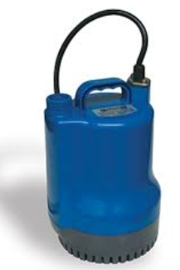
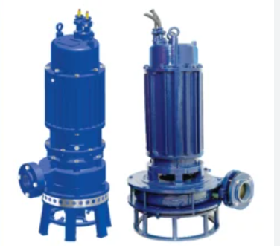
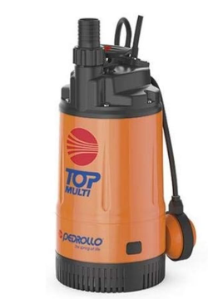
Dewatering pumps
Borehole Submersible Dewatering pump
Monoblock Dewatering Pump

Slide 20
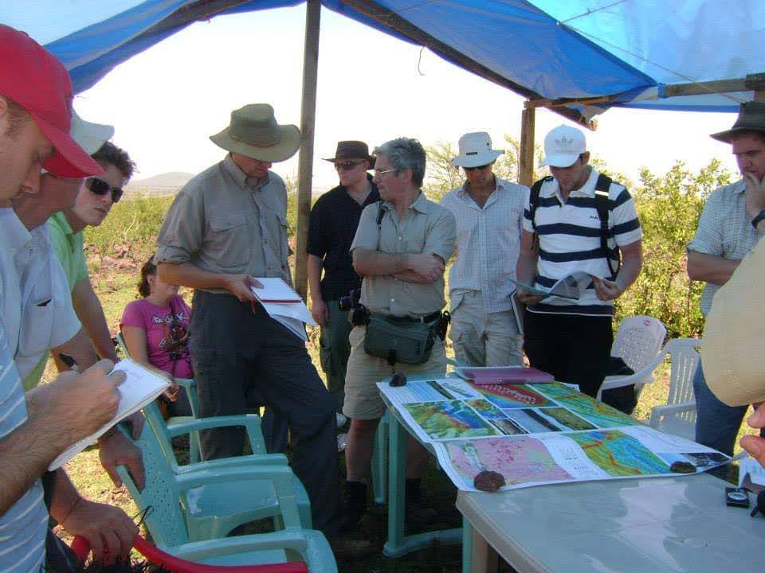
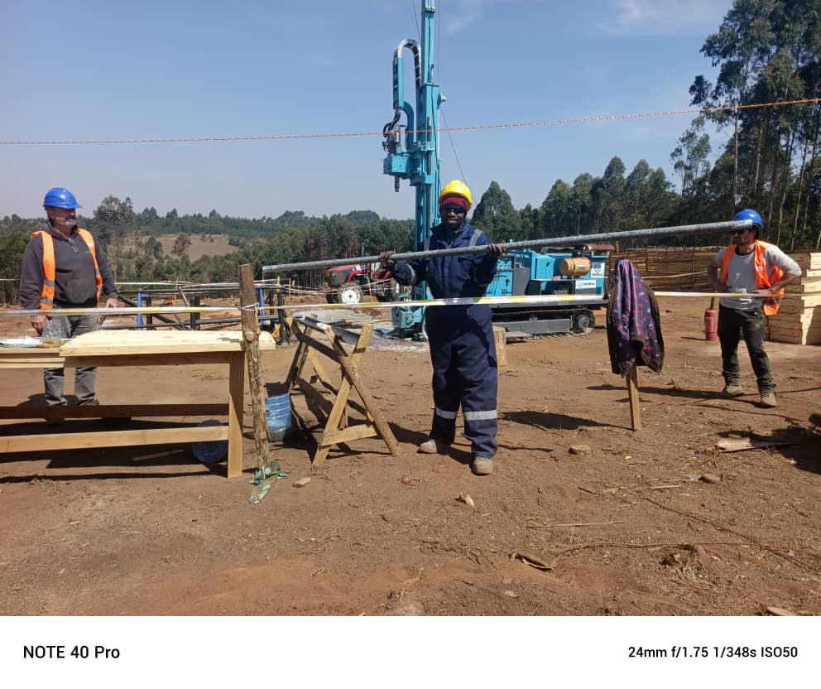
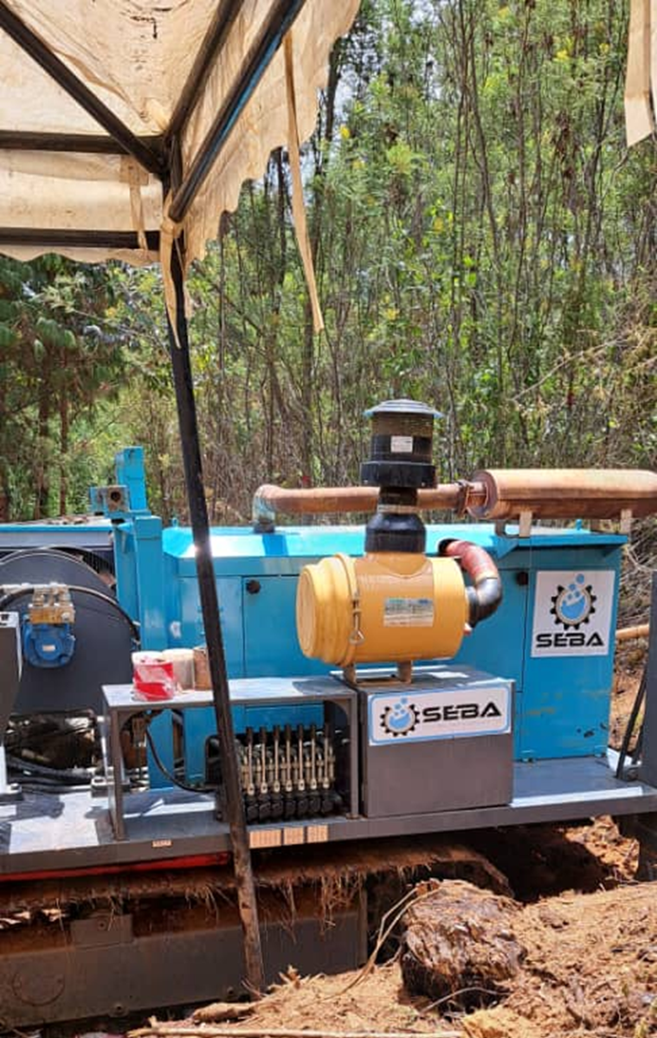
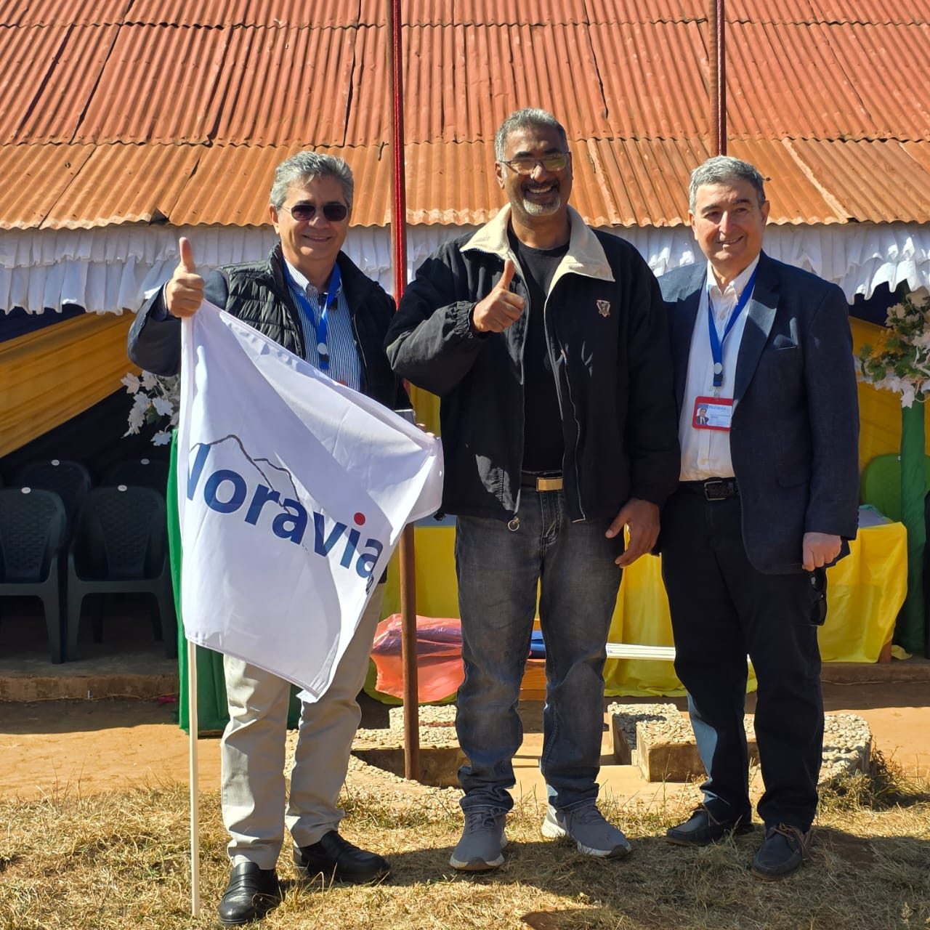
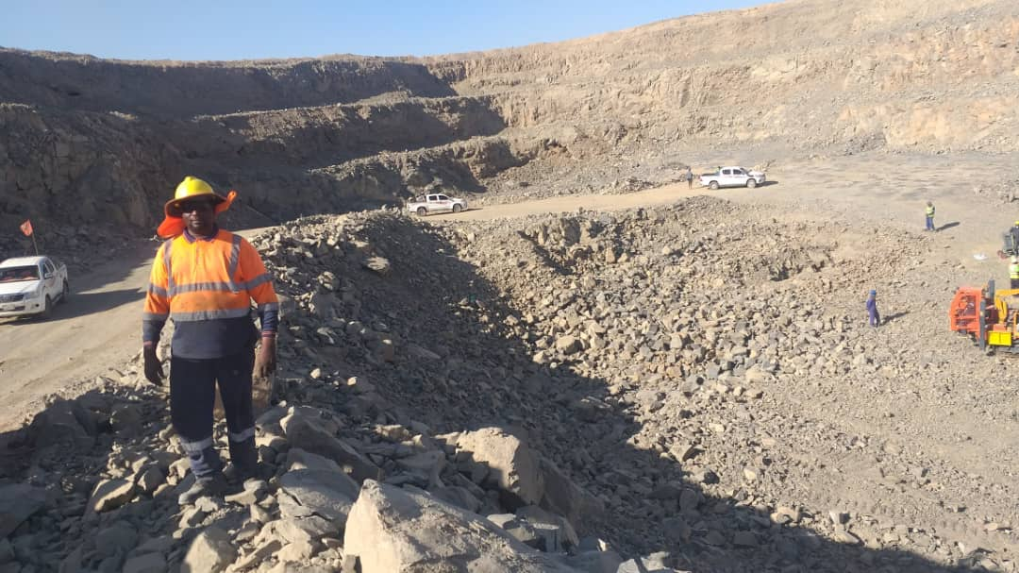
Exploration project
EXPLORATION : Our exploration division employs the best operators in the field and the most modern drilling technology to improve your sample quality

Slide 21
Exploration project
We provide a wide variety of drilling services including reverse circulation drilling, RAB drilling and surface Diamond drilling, we also provide blast hole drilling for surface mining operations and construction sites, probe drilling and in- pit RC grade control drilling and sampling. whatever you need, we can help with technical support, coverage and expansion for your projects. We can integrate within your team, work with your systems and processes or alternatively are happy to take the lead.

Slide 22
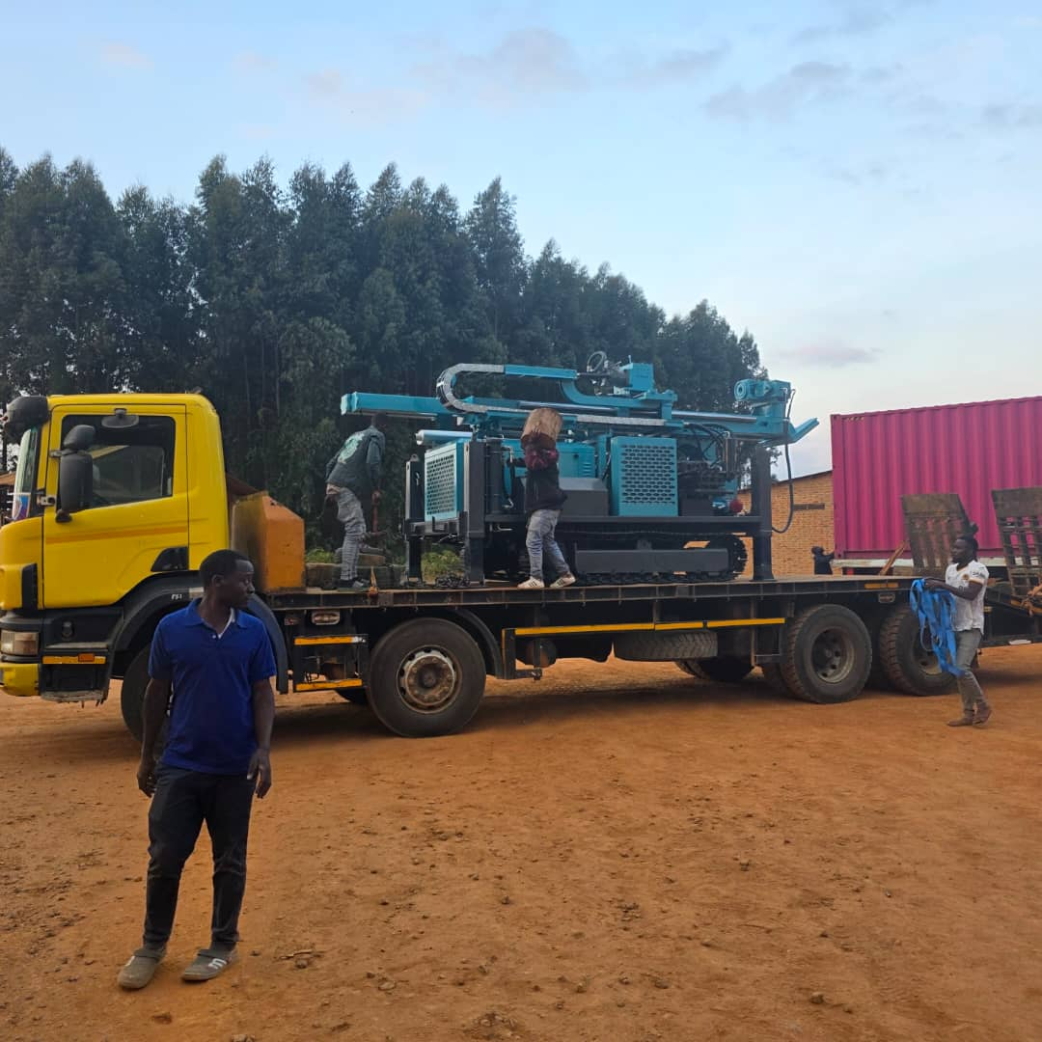
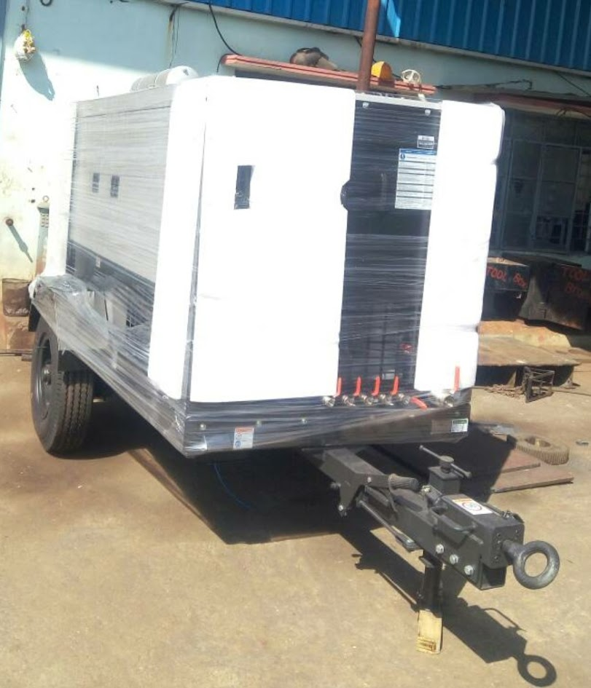
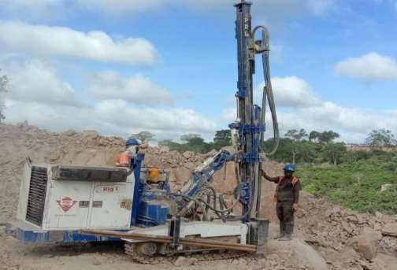
Some of Our Equipment Exploration project

Slide 23
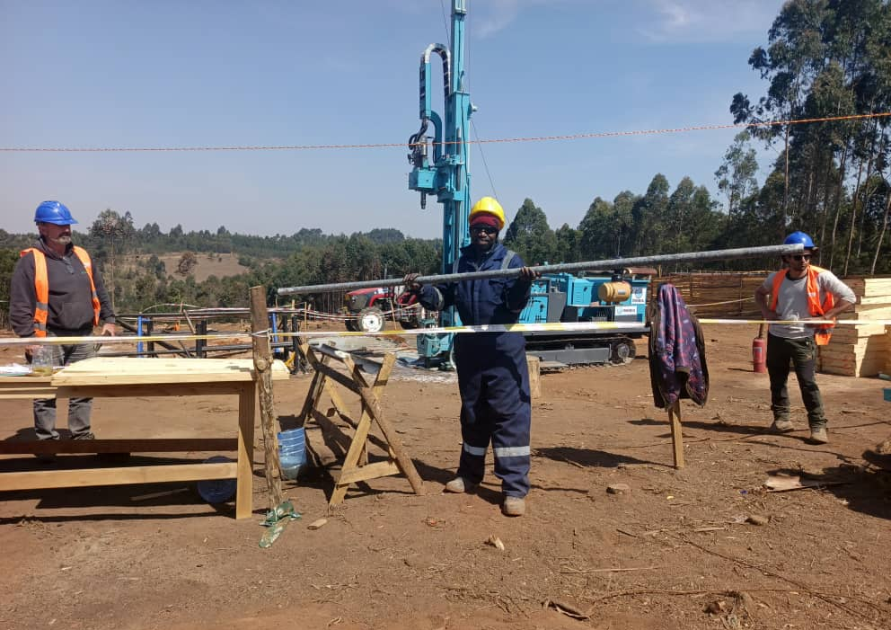
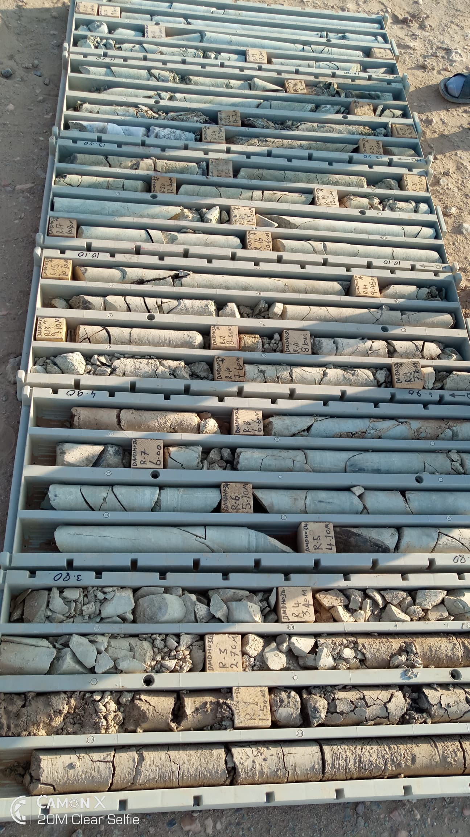
Seba drilling staff on site Exploration project

Slide 24
SOME OF FEW DRILLING PROJECTS DONE
S/N | PROJECT NAME | CLIENT | YEAR | CONTRACT SUM
1 | Noravia Gold (Tanzania)Ltd | Njombe District Council | 2025
2 | Sotta mine cooperation | Nyanzaga sengerema mwanza | 2017
3 | Construction of piped water Supply at Sitalike Village in Simbo District Council | Ruwasa, Katavi | 2018

Slide 25
SOME OF FEW DRILLING PROJECTS DONE
S/N | PROJECT NAME | CLIENT | YEAR | CONTRACT SUM
4 | Construction of piped water System and Civil Works for Ihenje Village Contract : LGA/143/2016/2017/W/12 | Gairo District Council | 2016
5 | Construction of Gravity of Water Supply Scheme at Isindagosi Village | Ruwasa Njombe | 2017
6 | Construction of piped water Supply at Sitalike Village in Simbo District Council | Ruwasa, Katavi | 2018

Slide 26
SOME OF FEW DRILLING PROJECTS DONE
S/N | PROJECT NAME | CLIENT | YEAR | CONTRACT SUM
7 | Construction of piped water Supply for Katsunga village in Nsimbo District Council (LGA.161/2017/2018/BHL/W/06/LOT 3 | Ruwasa Mpanda | 2019
8 | Extension of Chemchem Water Supply Scheme to Chekeleni village in Mtwara District in Mtwara Region | Ruwasa Mtwara | 2022-2023
9 | Feasibility Study Detail Design and Drilling 18 productive boreholes | Ruwasa,Kilosa | 2023-2024
Well Testing constant pumping test

Slide 27
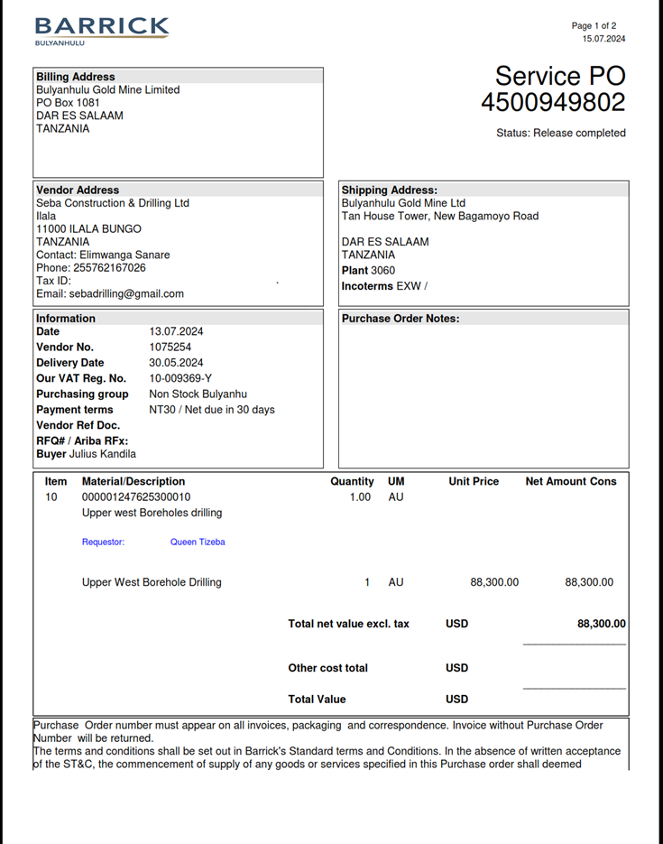
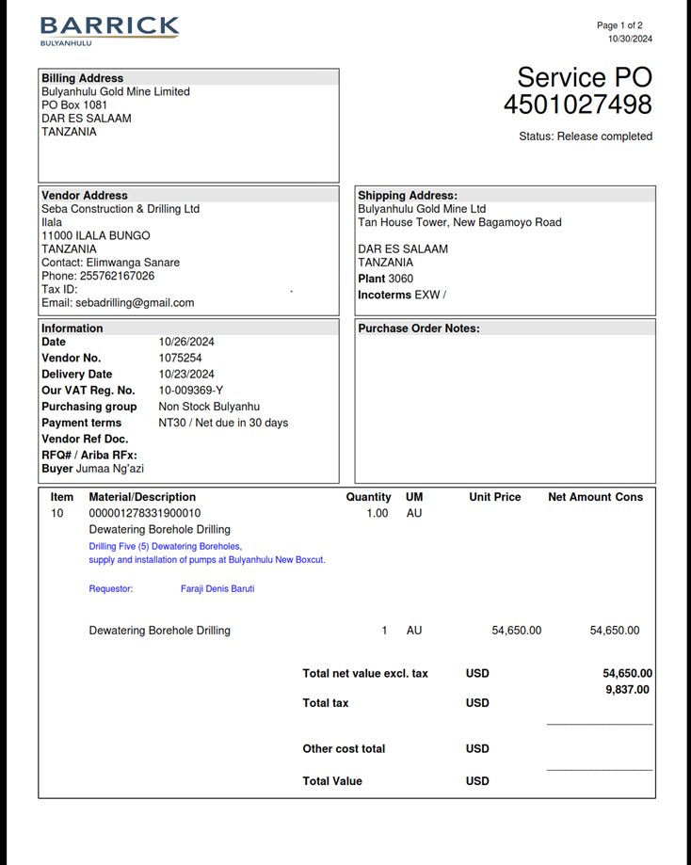
SOME OF FEW CERTIFICATE DRILLING PROJECTS DONE
Well Testing constant pumping test

Slide 28
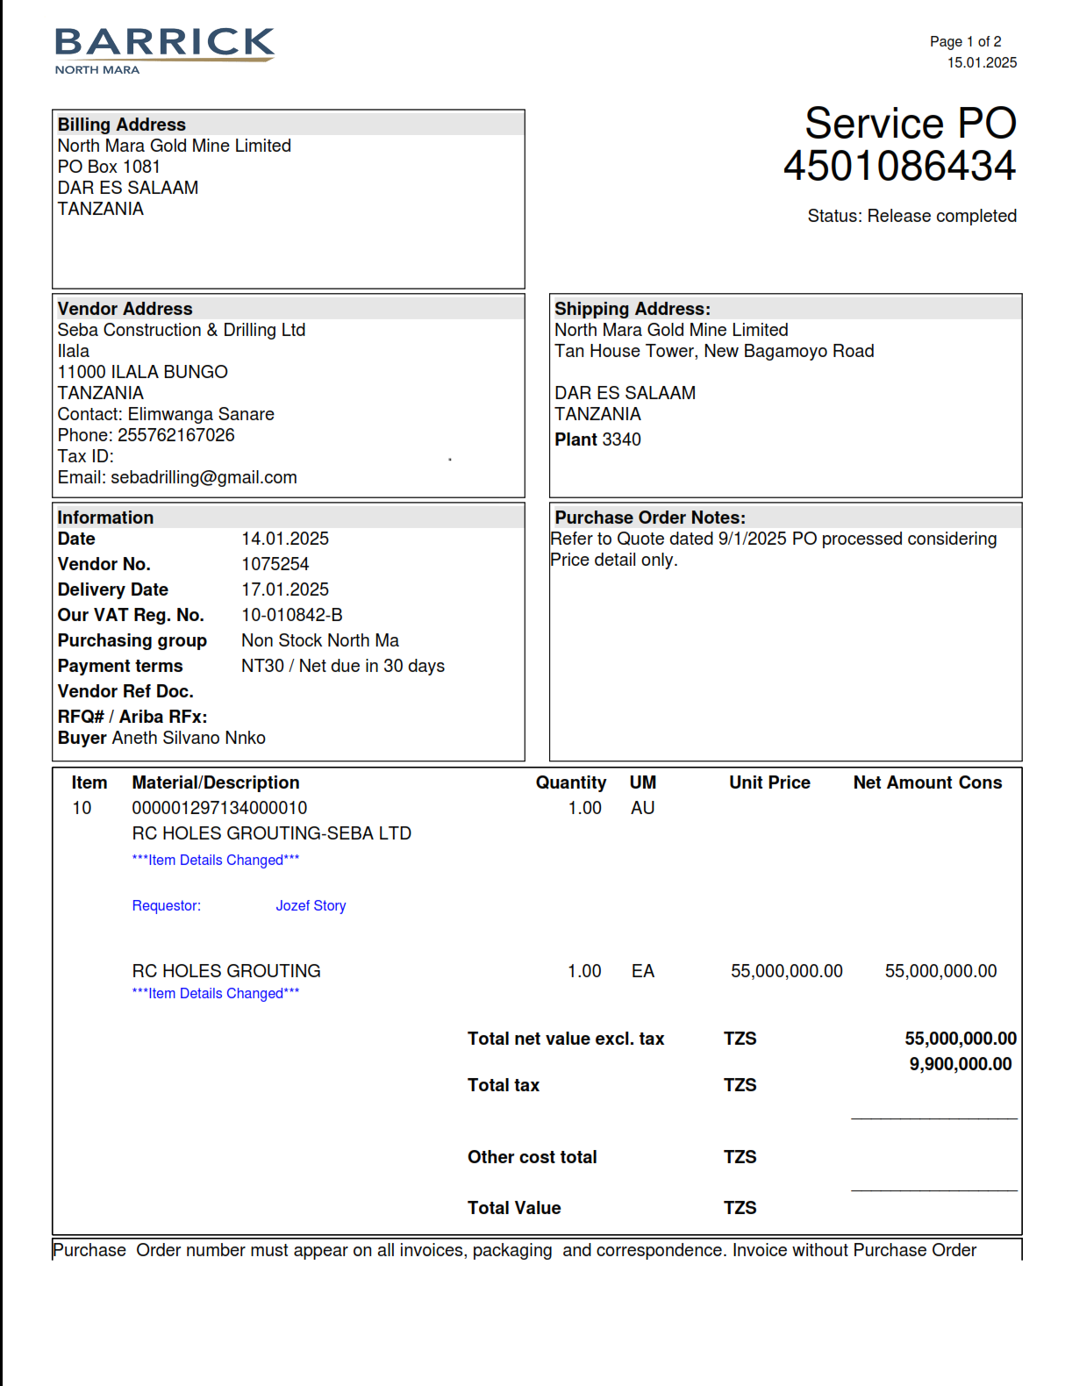
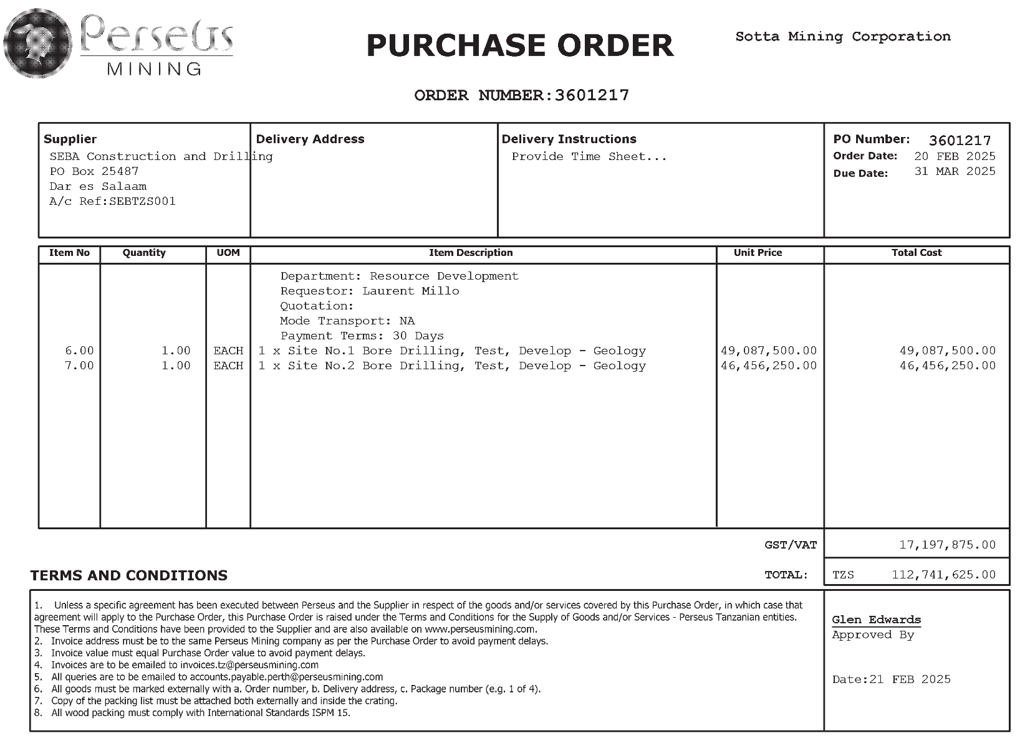
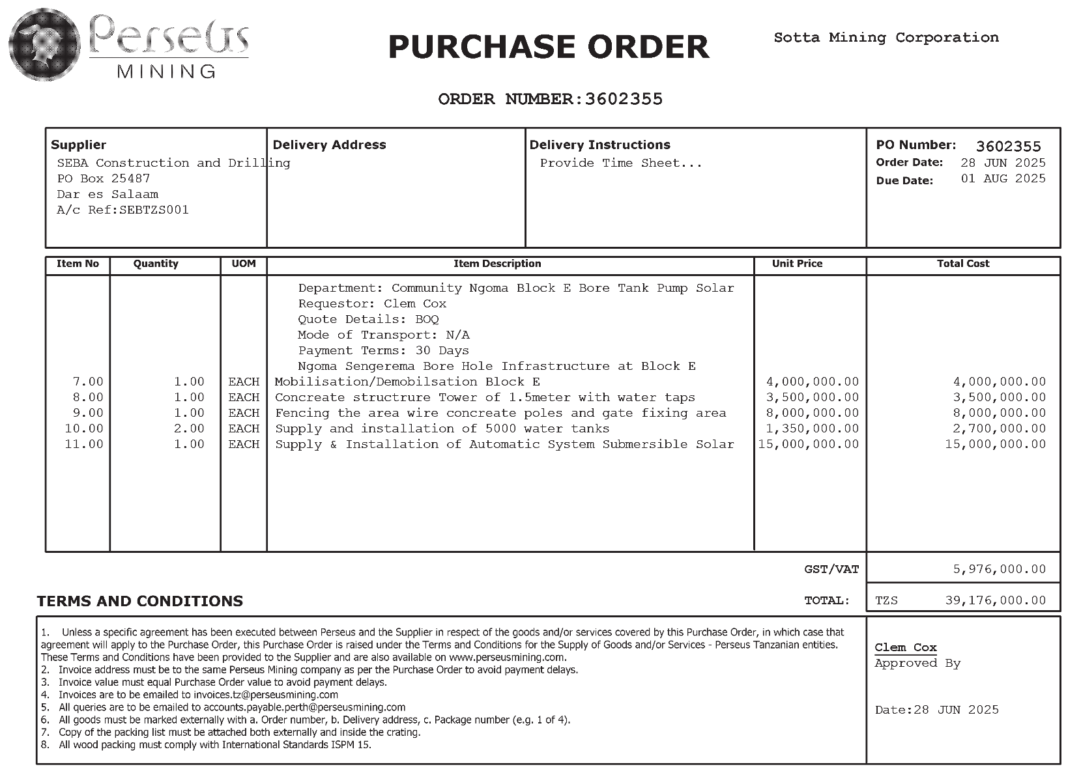
SOME OF FEW CERTIFICATE DRILLING PROJECTS DONE
Well Testing constant pumping test

Slide 29
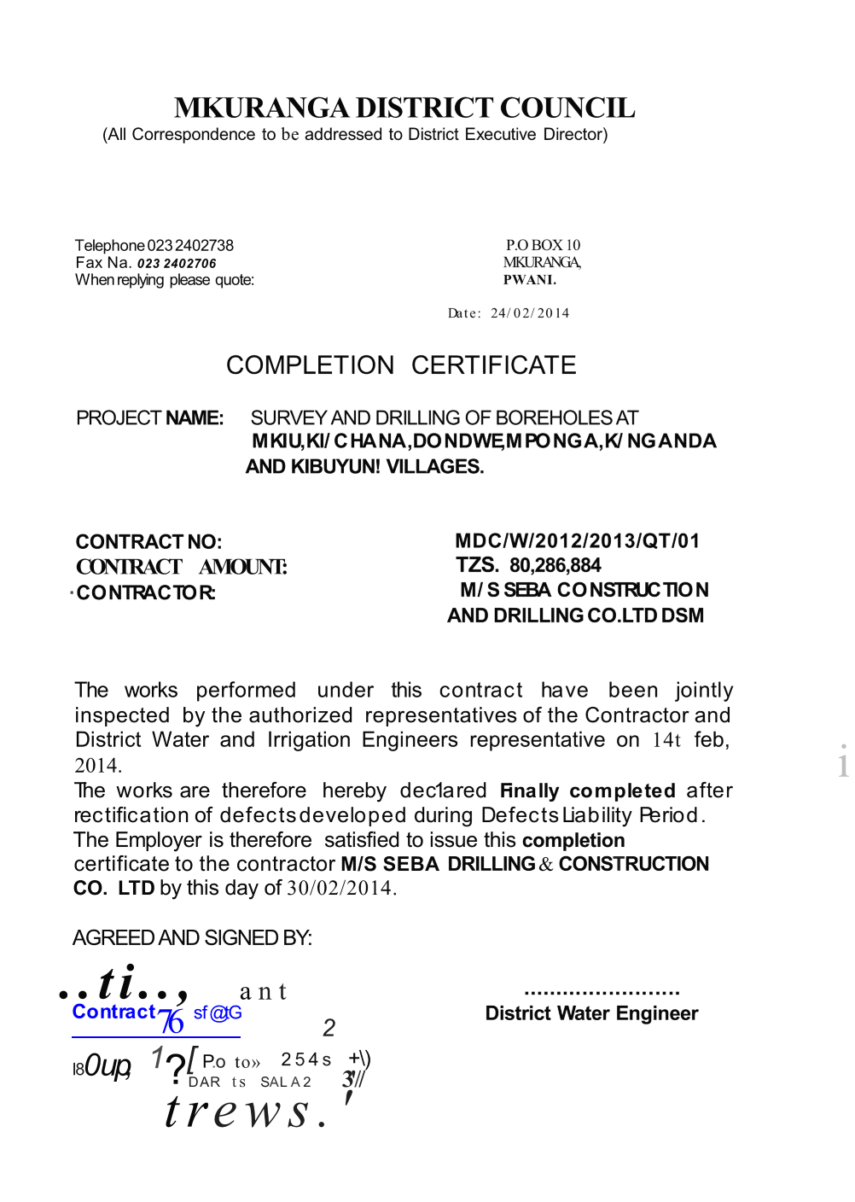
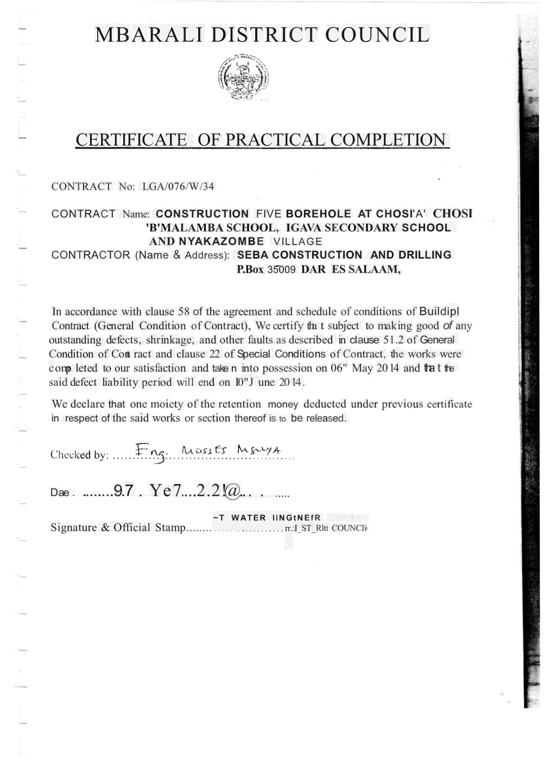
SOME OF FEW CERTIFICATE DRILLING PROJECTS DONE
Well Testing constant pumping test

Slide 30
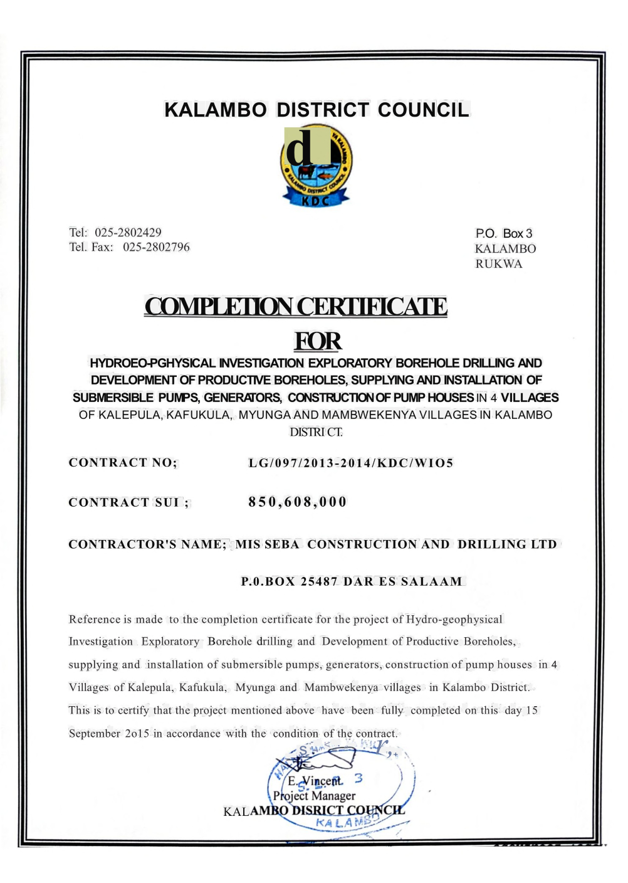
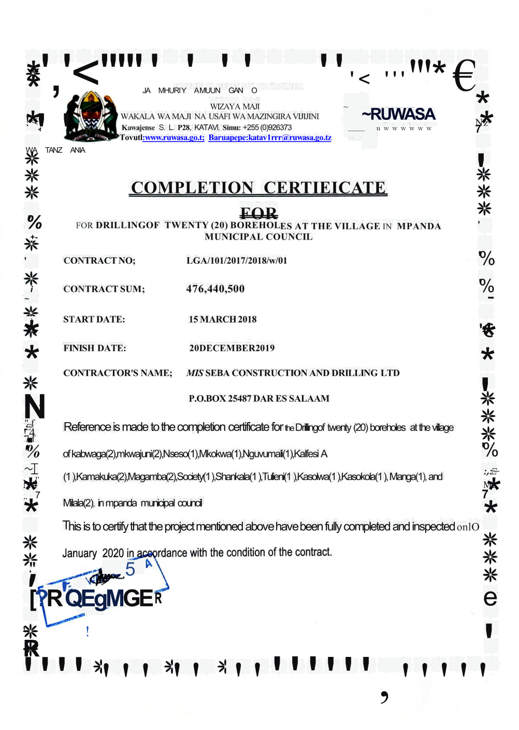

SOME OF FEW DRILLING PROJECTS DONE
Well Testing constant pumping test

Slide 31



SOME OF FEW DRILLING PROJECTS DONE
Well Testing constant pumping test

Slide 32


DRILLING EQUIPMENTS OWNED
Drilling Rig 350mtrs maximum drilling depth
Drilling Method DTH (Down to the hole)
Well Testing constant pumping test
Reverse Circulation Drilling Rig(RC) 450mtrs maximum(multipurpose RC & Diamond drilling
Drilling Method DTH(Down to the hole)

Slide 33
DRILLING EQUIPMENTS OWNED
Reverse Circulation Drilling Rig(RC) 200mtrs maximum(multipurpose RC & Diamond drilling
Drilling Method DTH(Down to the hole)
Well Testing constant pumping test
Diamond Drilling Rig(DD) 800mtrs maximum

Slide 34

DRILLING EQUIPMENTS OWNED
Blasting holes drilling Rig 40mtrs maximum drilling depth (Drilling Method DTH)
Well Testing constant pumping test
Drilling Rig 350mtrs maximum drilling depth
Drilling Method DTH(Down to the hole)

Slide 35

DRILLING EQUIPMENTS OWNED
Drilling Rig 350mtrs maximum drilling depth.
Drilling Method Mud Rotary.
Special for drilling loose formation clay and sandy.
Well Testing constant pumping test
we have different small size and this is the latest Submersible Pump for pumping test
This pump diameter 6”inch maximum pumping rate
Capacity 100,000 liters/hour

Slide 36



DRILLING EQUIPMENTS OWNED
Geophysical equipment for hydrogeological survey
ABEM TERRAMETER SAS 1000.
For Measure Resistivity .
Geophysical equipment for hydrogeological survey
PQWT S-300
PQWT S-300 Series geophysical prospecting instrument: This is used for natural electric field
Source working farm ,with resistivity contrasts underground rocks and minerals or ground water, based on measuring the natural electric field on the surface of the N different frequency electric field component, according to their different variation to the study.
Because this method measures the Electrical component of the electromagnetic field of the
Earth, so called natural electric field method. And we are using for (ERT) Electrical Resistivity Tomography.

Slide 37
CIVIL AND DUILDING CONSTRUCTION
2. Civil and Building construction we are competent and have already done multiple projects in different scopes,nature,scale and geographic conditions. We have constructed water supply projects, irrigation schemes, Construction of underground, on ground and raiser water tanks, we have also done construction of buildings and roads too.
Water Supply Projects
The scope of these projects comprise of Construction of treatment plants, Trench excavation laying of connected pipes and backfilling of the trenches. Also construction of storage tanks and water distribution points.
Irrigation Schemes
Are projects constructed with purpose of help increase the yield of productity of agriculture. In these projects we construct water canals designed to channel water from controlled water source to irrigate farm crops through the year. These projects serve as mitigation to the scarcity of rainfall through a Callender year.

Slide 38
CIVIL AND DUILDING CONSTRUCTION
Road projects
Road projects are divided into construction of new route,Maintenance and upgrading. Construction of new roads means establishing a totally new path where there was no corridor at all. You start from bush clearing and move to other layers.
Maintenance of roads also differs per state of existing road, it maybe periodic maintenance, Rehabilitation or sport improvement.
Also we have done upgrading of unpaved roads to bitumen standard level or rigid pavement to some parts where needed.

Slide 39




CIVIL WORKS EQUIPMENTS OWNED
Excavator
Motor grader
Steel drum roller
Concrete mixers
Backhoe loader

Slide 40
OUR KEY TECHNICAL PERSONEL
TITLE | QTY | MODE OF EMPLOYMENT
Civil Engineeers | 3 | permanent
Geology Engineer | 1 | Permanent
GIS expert/Land Suveyor | 1 | permanent
Drilling Experts | 5 | Permanent
Mining Technician | 1 | Permanent
HSE Officers | 2 | Permanent
Drillers | 5 | Permanent

Slide 41
CIVIL AND DUILDING CONSTRUCTION
S/N | PROJECT NAME | CLIENT | YEAR | CONTRACT SUM
 | Construction of Chitoholi Water Supply Scheme | Ruwasa,Tandahimba District | 2024
 | Rehablitation of Dihimba Water Supply Project in Mtwara District | Ruwasa, Mtwara District | 2023

Slide 42

SOME OF FEW CONSTRUCTION PROJECTS
1200 Cubic Metres Water Tank construction at Wang’ombe Njombe -Iringa Region project

Slide 43

SOME OF FEW CONSTRUCTION PROJECTS
Seba Construction and Drilling company we highly consider timely delivery of Construction projects while maintaining all standards as per scope of the work.
Water pumping House station construction at Wang’ombe Njombe –Iringa Region project.

Slide 44

Here under attached are just but a few of the civil construction project works that we have completed and others that are currently in progress.
All have been Proudly accomplished by Seba Construction & Drilling company Limited.
We ensure engineering projects abide by the relative professional standards for safety and quality.
Seba Construction and Drilling company we highly consider timely delivery of Construction projects while maintaining all standards as per scope of the work.
Water Tank Tower construction at Mpanda -Katavi Region project.

Slide 45

SOME OF FEW CONSTRUCTION PROJECTS
Seba Construction and Drilling company we highly consider timely delivery of Construction projects while maintaining all standards as per scope of the work.
Malatu Water Supply Scheme Mtwara Region project.

Slide 46
SOME OF FEW CONSTRUCTION PROJECTS
Seba Construction and Drilling company we highly consider timely delivery of Construction projects while maintaining all standards as per scope of the work.
Malatu Water Supply Scheme Mtwara Region project.

Slide 47


SOME OF FEW CONSTRUCTION PROJECTS
Box culvert construction
Rigid pavement construction

Slide 48



SOME OF FEW CERTIFICATE DOCOMENTS .

Slide 49


SOME OF FEW CERTIFICATE DOCOMENTS .

Slide 50


SOME OF FEW CERTIFICATE DOCOMENTS .

Slide 51

SOME OF FEW CERTIFICATE DOCOMENTS .

Slide 52

SOME OF FEW CERTIFICATE DOCOMENTS .

Slide 53
THANK YOU
SEBA DRILLING &CONSRTUCTION LTD ILALA, UHURU ROAD P.O.BOX 25487, DAR ES SALAAM TANZANIA.
Contact: +255712 666 666.
: +255753 666 668.
Email: info@sebadrilling.co.tz
: sebadrilling@gmail.com Web site: www.sebadrilling.co.tz

